Slide 1
CAPSTONE PROJECT
Dataset: Northwinds from Datawarehouse Sample K45_Nguyen Thi Ngoc Sam

Slide 2
Executive Summary
Audience
Sale Department
Type of Analysis
Sale Strategy
Context
Which are the Product Categories/ Markets that contributed to the significant revenue growth in the first fourth months of 1998 compared to the same period in the previous year?
Aha Moment
Focusing on key products and markets could increase revenue by an additional $428K in the first four months of 1999.

Slide 3
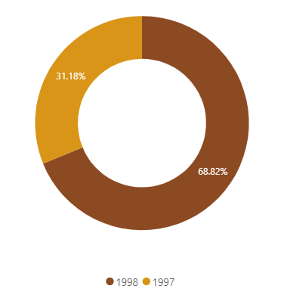
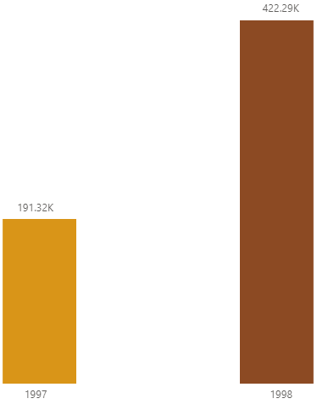
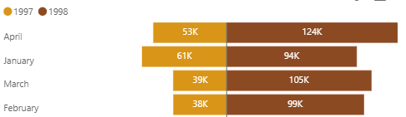
Revenue increased significantly at the beginning of 1998
The total revenue generated in the first four months of 1998 was double that of 1997. Notably, the revenue for February, March, and April 1998 was more than twice as high as in the same months of 1997.
Total revenue generated in the first four months of 1998 versus that of 1997
Revenue generated by each month in the first four months of 1998 versus that of 1997
2.2x

Slide 4
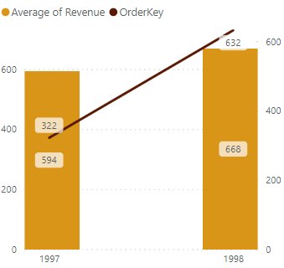
Revenue increased significantly because of…
Although the average revenue per product order slightly increased from 1997 to 1998 during the first four months of each year, the significant revenue growth in the first four months of 1998 was primarily due to a nearly doubling in the number of product orders, from 322 in 1997 to 632 (96.27% increase) in 1998.
Revenue = Number of product orders x Average revenue per product order
Number of product orders and average revenue per product order in the first four months of 1997 compared to 1998
YoY % change in the number of product orders during the first four months
YoY % change in average revenue per product order during the first four months
96.27%
12.46%

Slide 5
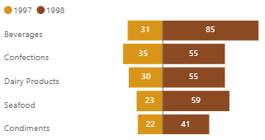
A large portion of product order increase comes from Europe
Europe accounted for a 60% increase in product orders during the first four months of 1998 compared to the same period in 1997. Specifically, beverages were Europe’s most-ordered product category in the first four months of 1998.
Product orders increased from each continent during the first four months of 1997 compared to 1998
Number of product category orders from Europe during the first four months of 1997 compared to 1998

Slide 6
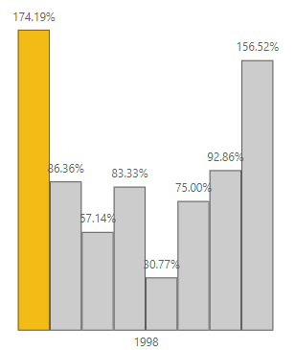
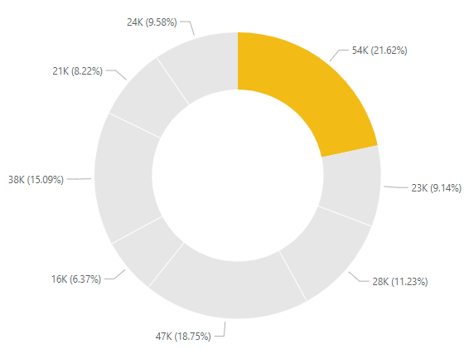

#1: Increase beverage orders from Europe
Revenue contributed by Europe regarding each product category during the first four months of 1998
Number of product category orders from Europe during the first four months of 1997 compared to 1998
+94K
In 1999
In the first four months of 1998, Europe's beverage orders generated $54K in revenue. If an order growth rate of 174.19% continues, an additional $94K is projected to be added to the revenue in 1999.

Slide 7
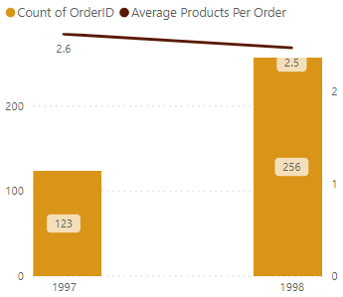
Product orders increased significantly because of…
The significant increase in the number of product orders in the first four months of 1998 was primarily driven by a surge in orders, rising from 123 in 1997 to 256 in 1998—a 108.13% increase. This growth offset a 5.69% decrease in the average number of products per order during the same period.
Number of product orders = Number of orders x Average products per order
Number of orders and average product per order in the first four months of 1997 compared to 1998
YoY % change in the number of orders during the first four months
YoY % change in average products per order during the first four months
108.13%
-5.69%

Slide 8
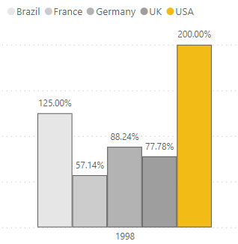
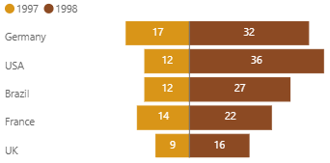
#2: Increase orders from the USA
Number of orders from the top 5 countries during the first four months of 1997 compared to 1998
YoY % change in the number of orders from the top 5 countries during the first four months
Revenue contributed by the USA during the first four months of 1998
86K
Expected revenue increase contributed by the USA in the first four months of 1999 compared to 1998
+172K
The number of orders from the USA in the first four months of 1998 showed the highest growth among the five countries, with a growth rate of 200% compared to 1997. If this growth rate continues at 200%, the number of orders from the USA in 1999 is expected to reach 108, which will contribute an additional $172K to the revenue from the USA for the first four months of 2010.

Slide 9
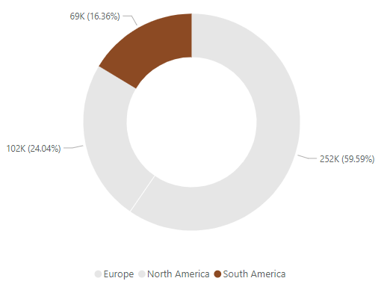
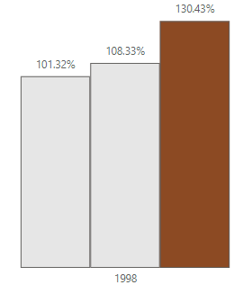

#2: Increase orders from South America
Revenue contributed by South America during the first four months of 1998
YoY % change in the number of orders from South America during the first four months
+90K
In 1999
Although South America generated the least revenue in the first four months of 1998 (16.36%), it exhibited the highest growth rate among the three continents, with a 130.43% increase compared to the same period in 1997. If this growth rate persists, an additional $90,000 in revenue is projected for the first four months of 1999.

Slide 10
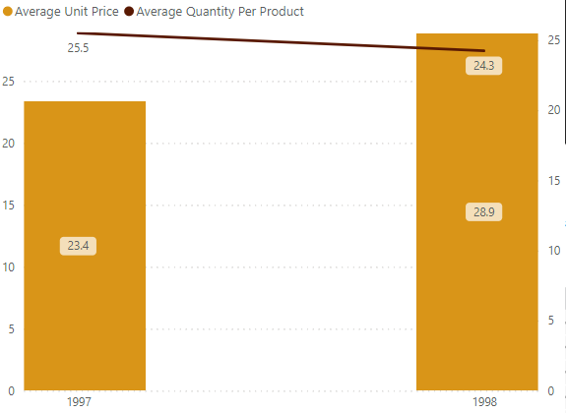
Average revenue per product order increased slightly due to…
The increase in the average revenue per product order in the first four months of 1998 was primarily driven by a surge of 23.64% in average unit price. This growth offset a 4.95% decrease in the average quantity per product during the same period.
Average revenue per product order = Average quantity per product x Average unit price
Average quantity per product and average unit price in the first four months of 1997 compared to 1998
YoY % change in average quantity per product during the first four months
YoY % change in average unit price during the first four months
-4.95%
23.64%

Slide 11
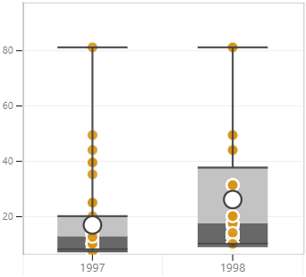
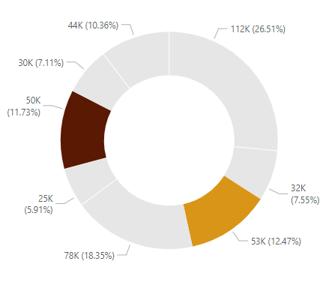
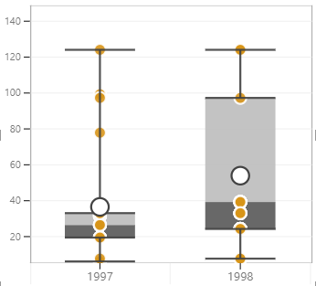
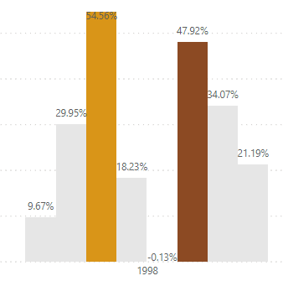

#3: Increase the unit price of confection and meat/poultry
The average unit price of confection products during the first four months of 1997 compared to 1998
Revenue contributed by each product category during the first four months of 1998
Revenue contributed by confection and meat/poultry during the first four months of 1998
103K
Expected revenue increase contributed by confection and meat/poultry in the first four months of 1999 compared to 1998
The average unit price of meat/poultry during the first four months of 1997 compared to 1998
YoY % change in the average unit price of each product category during the first four months
+53K
The average unit price of confection and meat/poultry products in the first four months of 1998 both increased significantly compared to 1997, with a growth rate of 54.56% and 47.92%, respectively. If these growth rates continue, confection and meat/poultry products will contribute an additional $53K to the revenue for the first four months of 2010.

Slide 12
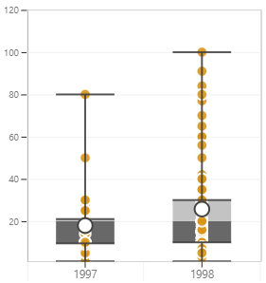
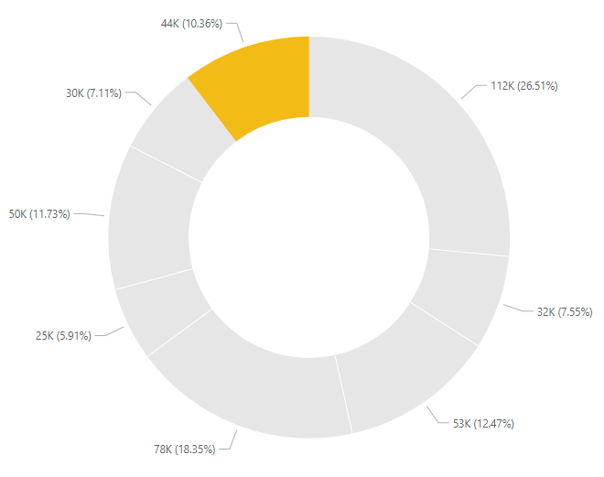
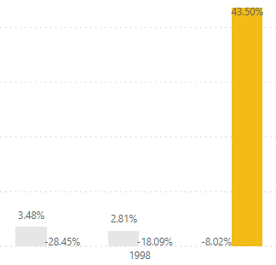

#4: Increase average quantity per seafood product
The average quantity per seafood product during the first four months of 1997 vs. 1998
Revenue contributed by each product category during the first four months of 1998
YoY % change in the average quantity per each product category during the first four months
+19K
In 1999
While the overall average quantity per product decreased in the first four months of 1998 compared to 1997, the seafood category was the only one to see a significant increase, with a growth rate of 43.5%. Customers showed a preference for buying larger quantities of seafood during this period. If this trend continues, seafood products could add $19K to revenue in the first four months of 2010.

Slide 13
Aha moment
$428,000
Focusing on key products and markets could increase revenue by an additional $428K in the first four months of 1999.

Slide 14
Solutions
1
2
Increase orders from the USA and South America
Increase beverage orders from Europe
Increase the average quantity per seafood product
4
3
Increase the unit price of confection and meat/poultry

Slide 15
Thank you!

